Slide 1
Operating Systems

Slide 2
Operating System
What is an Operating System?
A program that controls the execution of application programs
An interface between applications and hardware
A program that manages hardware resources and task scheduling
Primary functionality
Exploits the hardware resources of one or more processors
Provides a set of services to system users
Manages secondary memory and I/O devices
Objectives
Convenience: Makes the computer more convenient to use
Efficiency: Allows computer system resources to be used in an efficient manner
Ability to evolve: Permit effective development, testing, and introduction of new system functions without interfering with service

Slide 3
Linux Distributions
Alphanet Linux
Alzza Linux
Andrew Linux
Apokalypse
Armed Linux
ASPLinux
Bad Penguin
Bastille Linux
Best Linux
BlackCat Linux
Blue Linux
Bluecat Linux
BluePoint Linux
Brutalware
Caldera OpenLinux
Cclinux
ChainSaw Linux
CLEClIeNUX
Conectiva
CoolLinux
Coyote Linux
Corel
COX-Linux
Darkstar Linux
Debian Definite Linux
deepLINUX
Delix
Dlite (Debian Lite)
DragonLinux
Eagle Linux M68K
easyLinux
Elfstone Linux
Embedix
Enoch
Eonova Linux
ESware
Etlinux
Eurielec Linux
FinnixFloppi Gentoo Linux
Gentus Linux
Green Frog Linux
Halloween Linux
Hard Hat Linux
HispaFuentes
HVLinux
Icepack
Immunix OSIndependence
InfoMagick Workgroup Server
Ivrix
ix86 Linux
JBLinux
Jurix Linux
Kondara
Krud
KW Linux
KSI Linux
L13Plus
Laser5
Leetnux
Lightening
Linpus Linux
Linux Antarctica
Linux by Linux
Linux GT Server Edition
Linux Mandrake
Linux MX
LinuxOne
LinuxPPC
LinuxPPP
LinuxSIS
LinuxWare
Linux-YeS
LNX System
Lunet
LuteLinux
LST
Mastodon
MaxOS&trade
MIZI Linux OS
MkLinux
MNIS Linux
MicroLinux
Monkey Linux
NeoLinux
Newlix OfficeServer
NoMad Linux
Ocularis
Open Kernel Linux
Open Share Linux
OS2000
Peanut Linux
PhatLINUX
PingOO
Plamo Linux
Platinum Linux
Power Linux
Progeny Debian
Project Freesco
Prosa Debian
Pygmy Linux
Red Flag Linux
Red Hat Linux
Redmond Linux
Rock Linux
RT-Linux
Scrudge Ware
Secure Linux
Skygate Linux
Slacknet Linux
Slackware
Slinux
SOT Linux
Spiro
Stampede Linux
Storm Linux
S.u.SE
Thin Linux
TINY Linux
Trinux
Trustix Secure Linux
TurboLinux
Turquaz
UltraPenguin
Ute-Linux
VA-enhanced RedHat Linux
VectorLinux
Vedova Linux
Vine Linux
White Dwarf Linux
Whole Linux
WinLinux 2000
WorkGroup Solutions
Linux Pro Plus
Xdenu
Xpresso Linux 2000
XTeam Linux
Yellow Dog Linux
Yggdrasil Linux
ZiiF Linux
ZipHam
ZipSlack

Slide 4
Services Provided by the OS
Program development
Editors and debuggers
Program execution
Access to I/O devices
Controlled access to files
System access
Protection
Error detection and response
Internal and external hardware errors
Software errors
Operating system cannot grant request of application
Accounting

Slide 5
What is an OS?
A program which controls execution of application programs
An interface between applications and hardware
Primary functionality:
Exploits hardware of multiple processors
Services to users
Manages memory and io
Design objectives:
Convenient – both for users and administrators
Efficient
Reliable (fault tolerant to some degree, both hardware and software)
Modular enough to add new features.

Slide 6
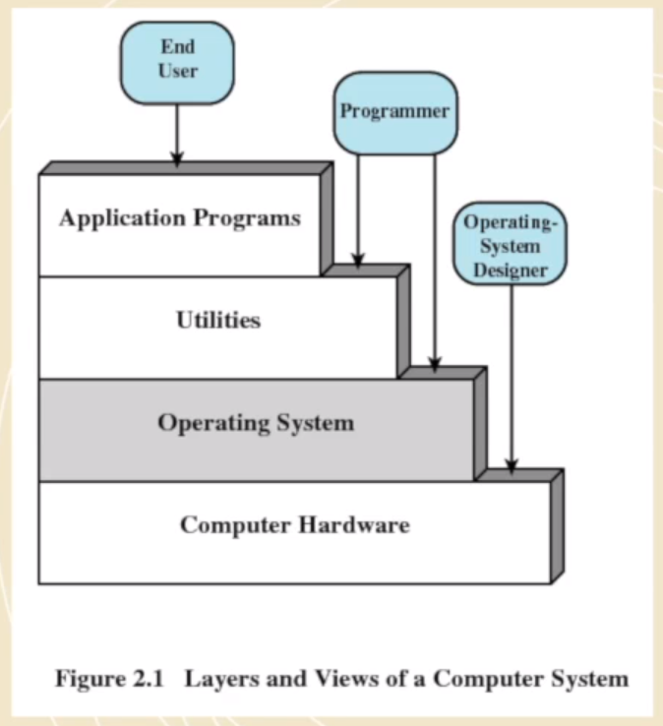
Older view of the role of an OS

Slide 7
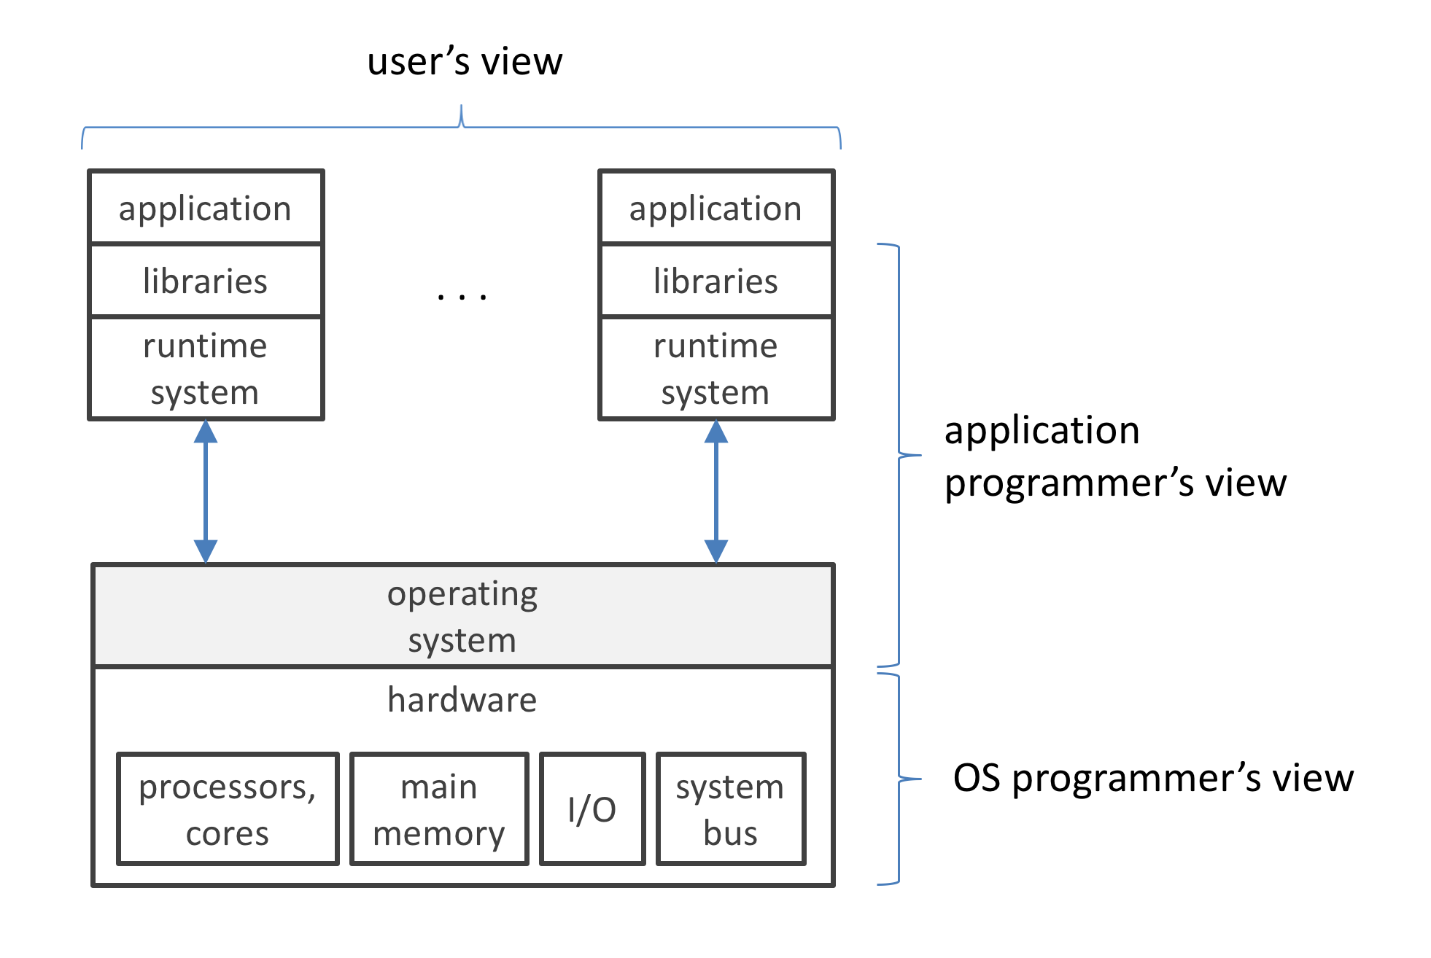

Slide 8
Resources Managed by the OS
Processor
Main Memory
volatile
referred to as real memory or primary memory
I/O modules
secondary memory devices
communications equipment
terminals
System bus
communication among processors, memory, and I/O modules

Slide 9
OS Structure
We could look at various components and their interconnections (software)
Interfaces for programmers
System elements
Process management
Main Memory Management
File management
I/O
Secondary storage
Networking
Protection features (both from wilful attacks or from buggy code)

Slide 10
OS Services
Program Execution: Load a program into memory, execute it, end execution etc.
I/O Operations
File System operations (read, write, copy, delete)
Communication between processes
Error detection and handling – Monitoring for errors and preventing a system crash

Slide 11
Multiprogramming and Multitasking
Mutliprogramming –
Single user cannot keep CPU and IO busy at all times
Multiprogramming organizes jobs so CPU always has something ot do.
One job selected and run via scheduling
When a job is waiting, OS switches to another
Timesharing (multitasking)
Response time should be short (~ms)
Many users have programs running at once – process scheduling
Several jobs trying to run means CPU scheduling
If nothing is running programs are swapped in memory (that takes time)
Virtual memory allows a program to think there is memory available even when it isn’t

Slide 12
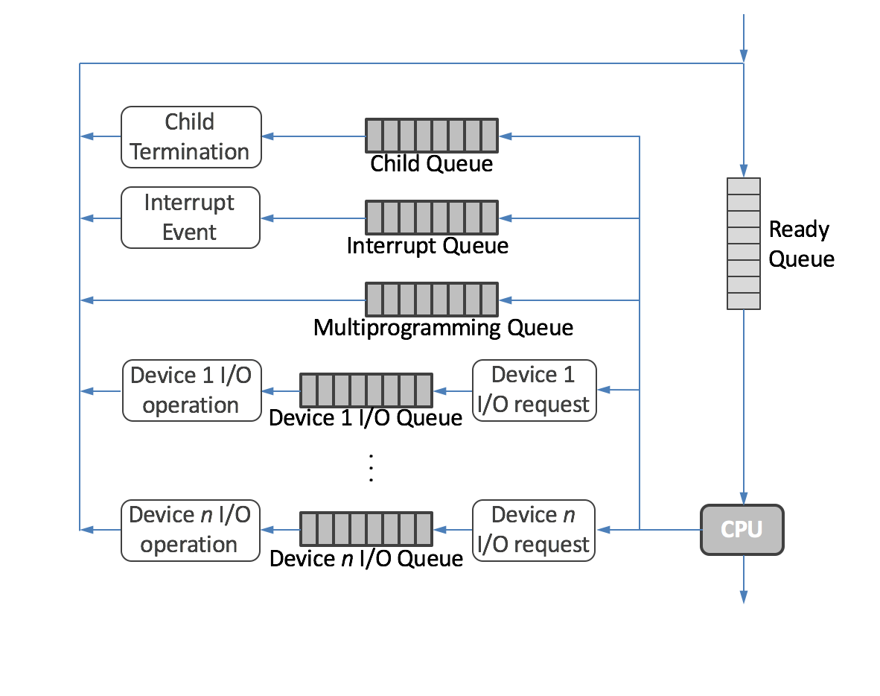
At the heart of the process management services supported by the OS is the cross-cutting functionality of process scheduling: the determination of what processes are given the necessary physical resources to run and when they are allocated.
The job queue holds all processes, whatever their states, and any new process entering the system is put in the job queue by the OS. A representative job queue may include a ready queue, child queue, interrupt queue, multiprogramming queue, and I/O queues.

Slide 13
Process Management
Program is a passive entity/Process is active
Process needs resources (CPU/Memory/IO)
Process has a program counter, Process stack, code, and data
Process termination reclaims resources to the OS for other programs
Single threaded programs have 1 program counter – that’s the address of the next instruction to execute
Multi-threaded has one PC per thread
Typically a system has many processes, some users, and one OS running concurrently on one or more CPU

Slide 14
Process
A process can be in one of a few states – New (being created), Running, waiting, ready and terminated.
It may move from ready to waiting to running
(I could draw a finite state machine for this)

Slide 15
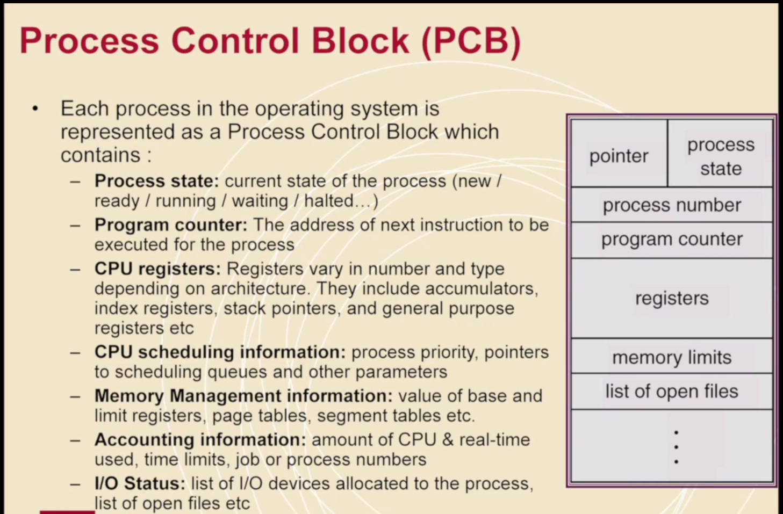
Process Control Block

Slide 16
Process Management
Create and Delete both user and system processes
Suspend and resume processes
Synchronisation
Communication (like MPI)
Deadlock handling

Slide 17
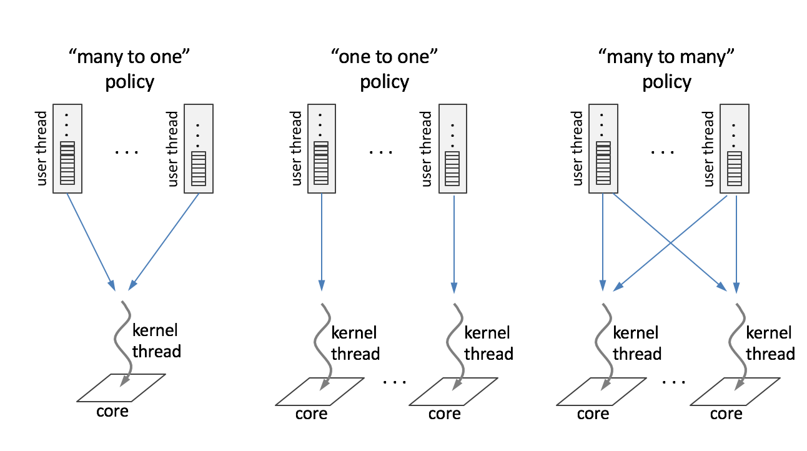
The runtime system allocates the kernel threads made available to it to the user threads for which it is responsible in several different ways.

Slide 18
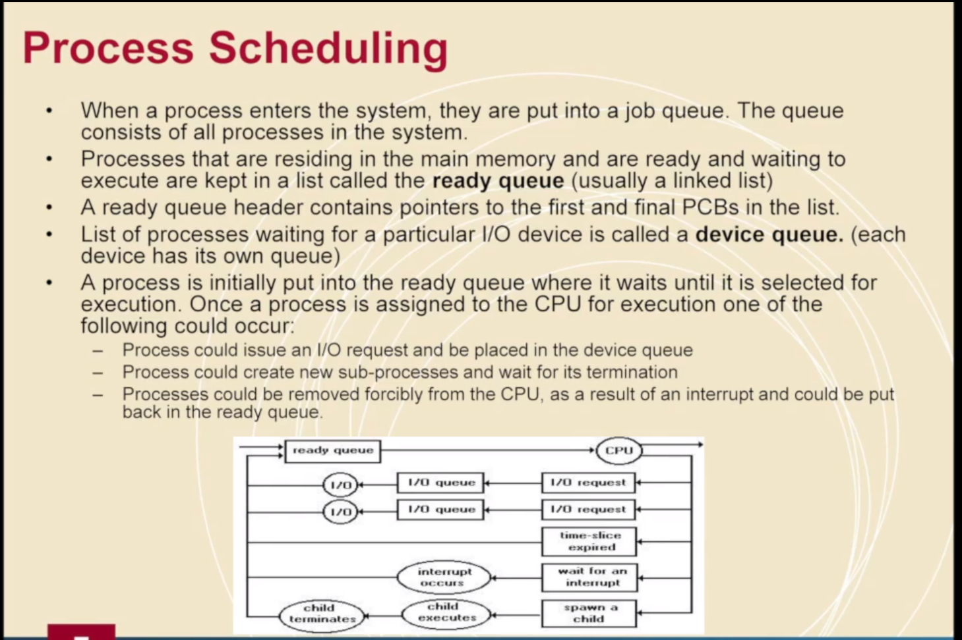

Slide 19
Process Schedulers
The OS has to be programmed which scheduling algorithm to use for which device.
Processes need to be spooled (queued) up on a mass storage device
The longer term scheduler selects which one to load up into memory
Note that in a super computer the scheduler may factor in fees/cost to a process which is not the case in a home use machine
The short term scheduler selects from the processes that are ready which one to execute, and allocates CPU time to them
(We don’t tend to think about long term schedulers in home computing)

Slide 20
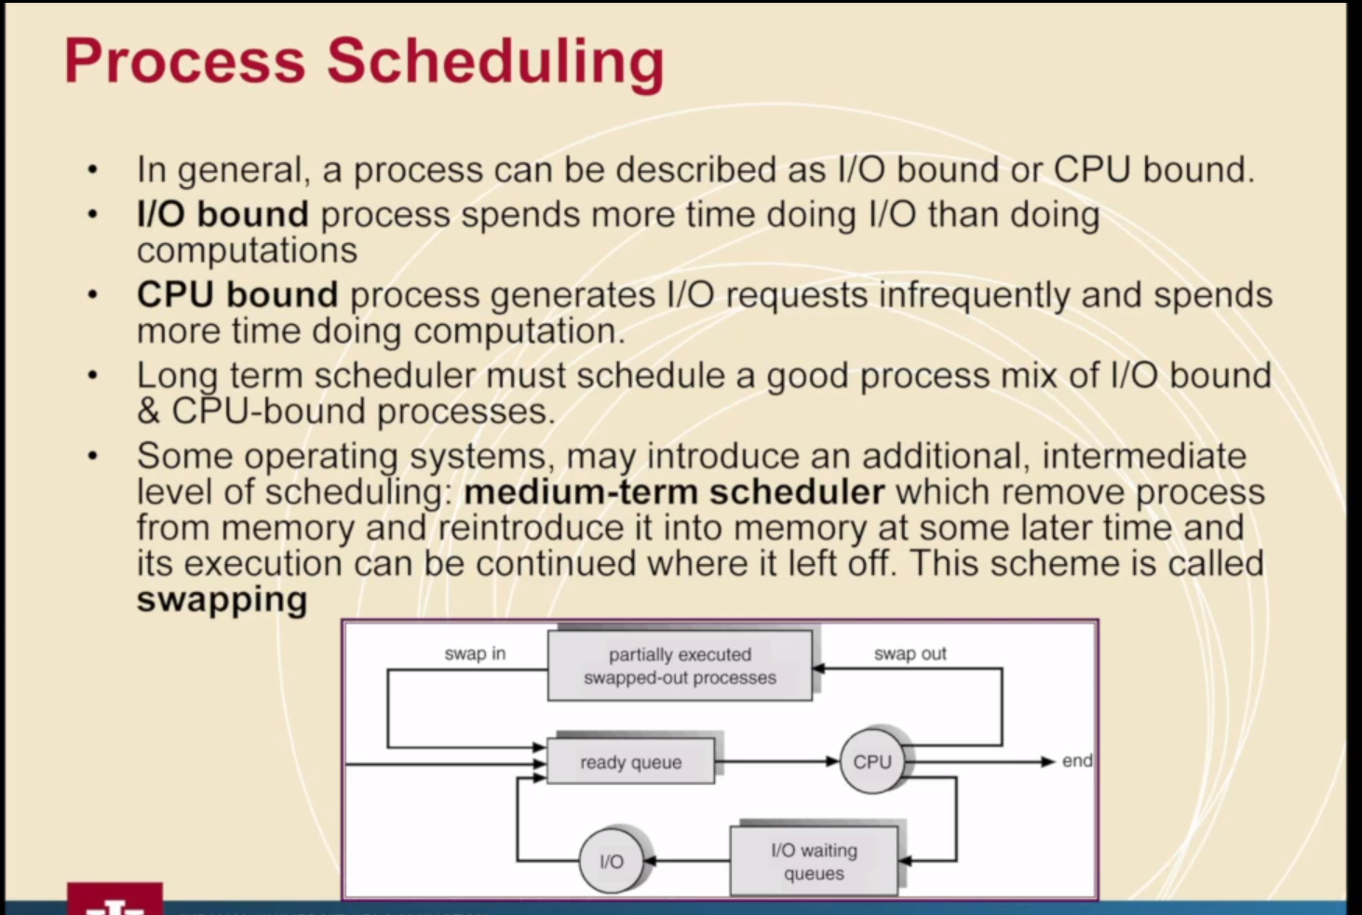
Notes:
Note context switching (moving a process into a process core)

Slide 21
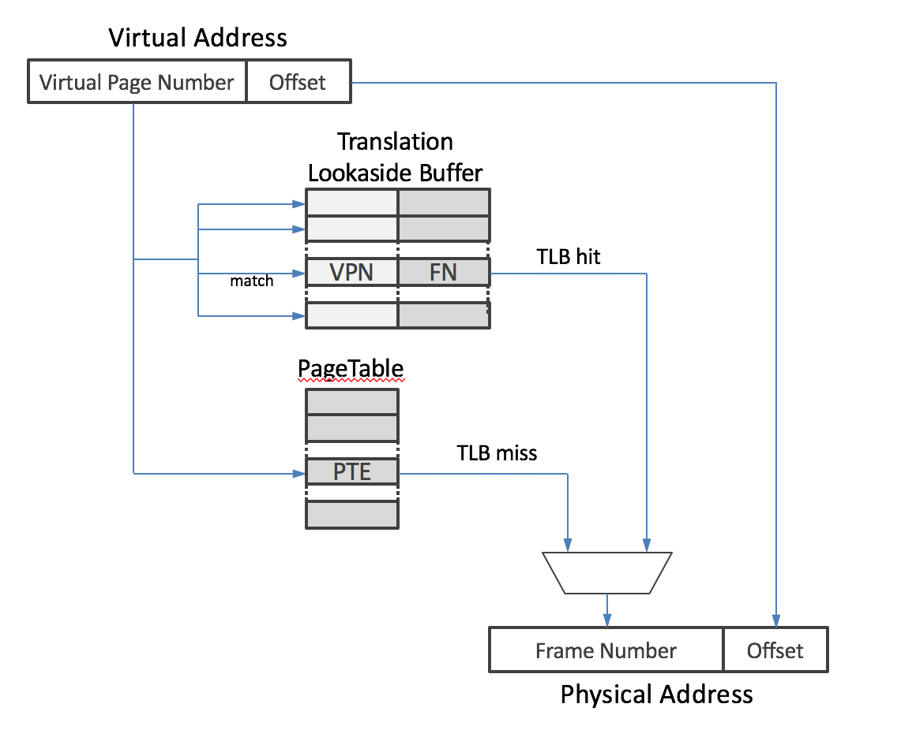
The translation lookaside buffer (TLB) is a special-purpose cache that operates to provide high-speed mapping of virtual page numbers to main memory frame numbers for recently used stored data.

Slide 22
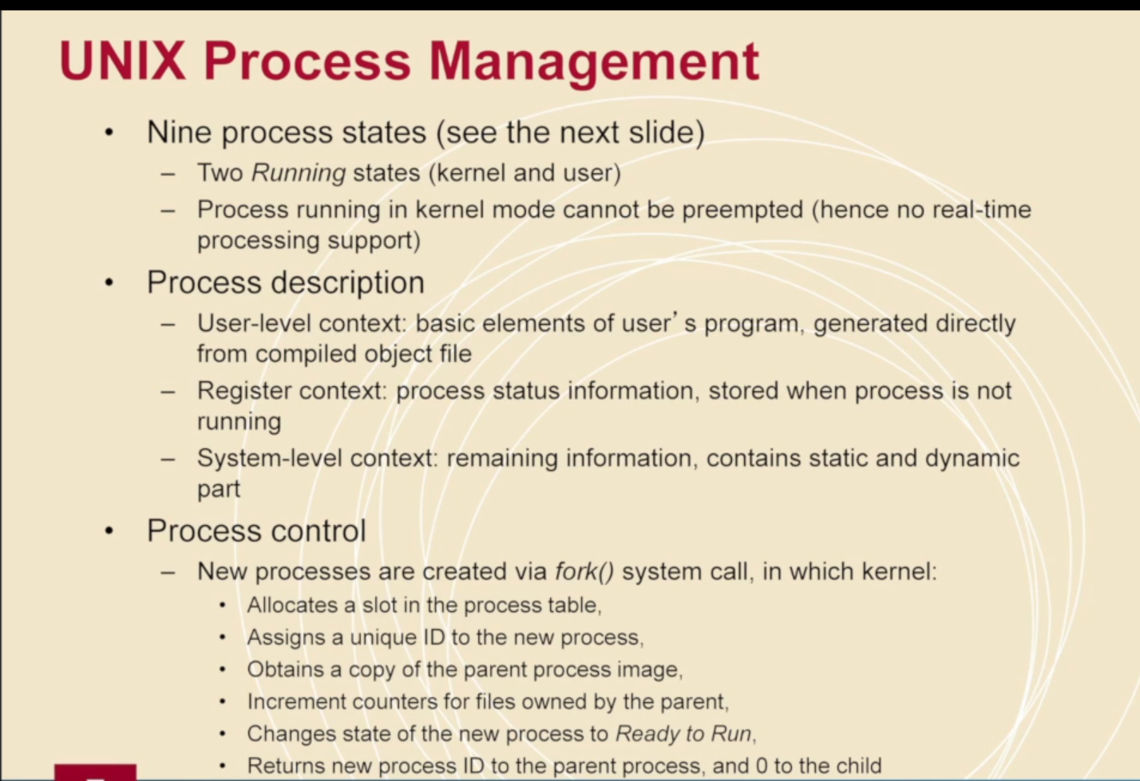

Slide 23
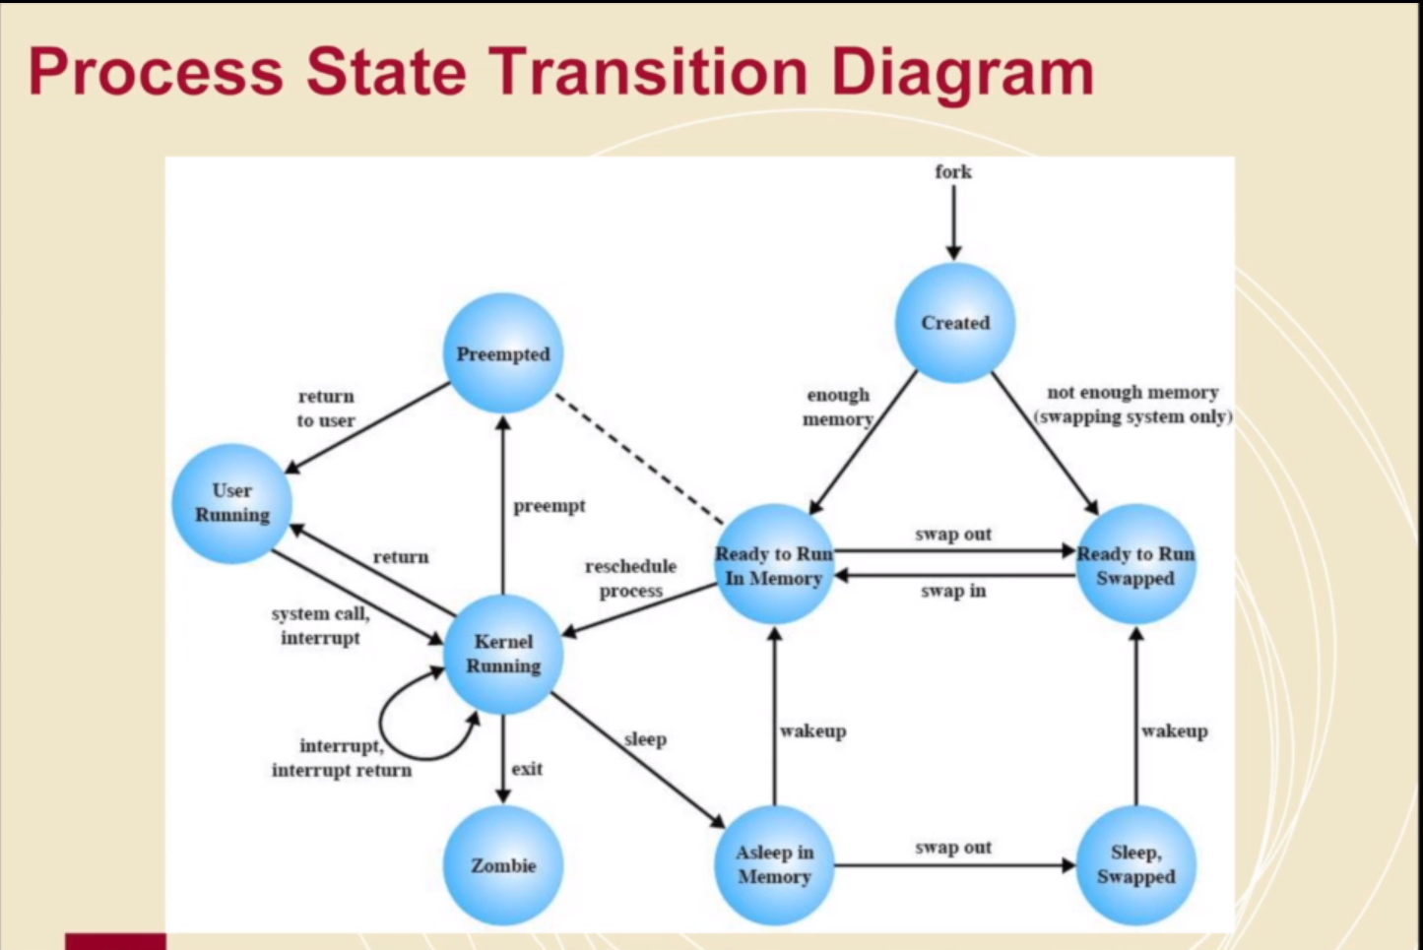

Slide 24
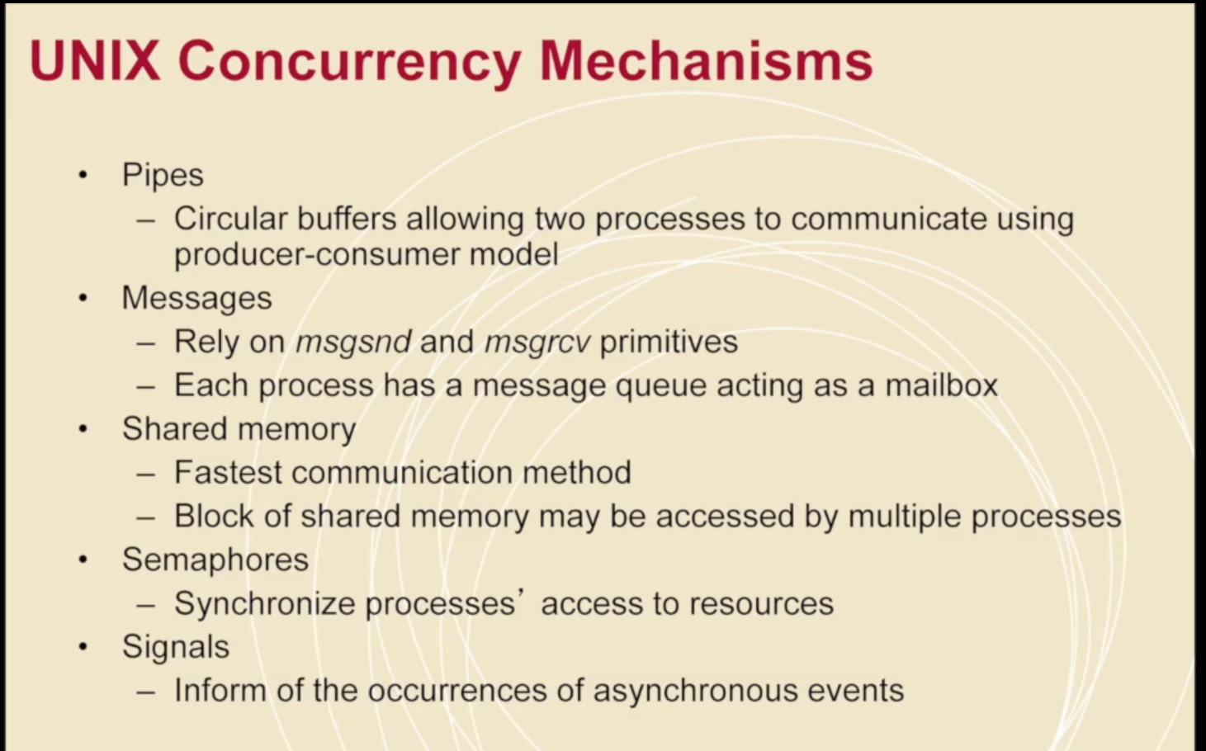

Slide 25
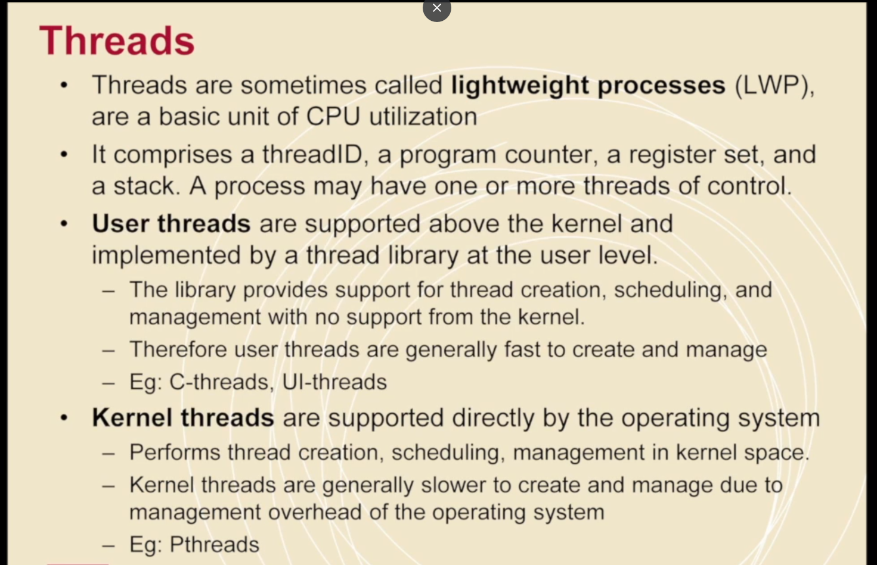

Slide 26
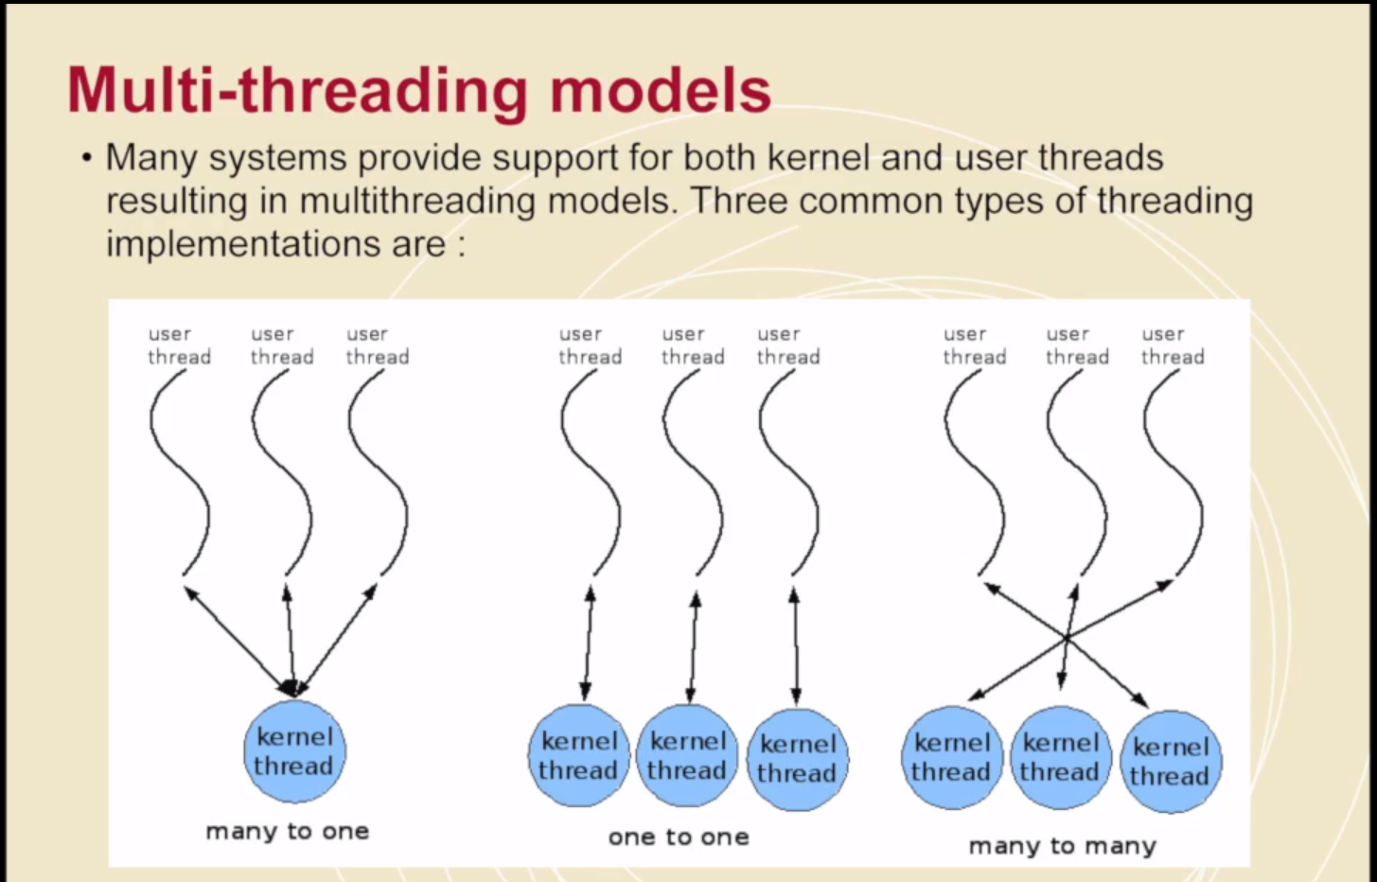

Slide 27
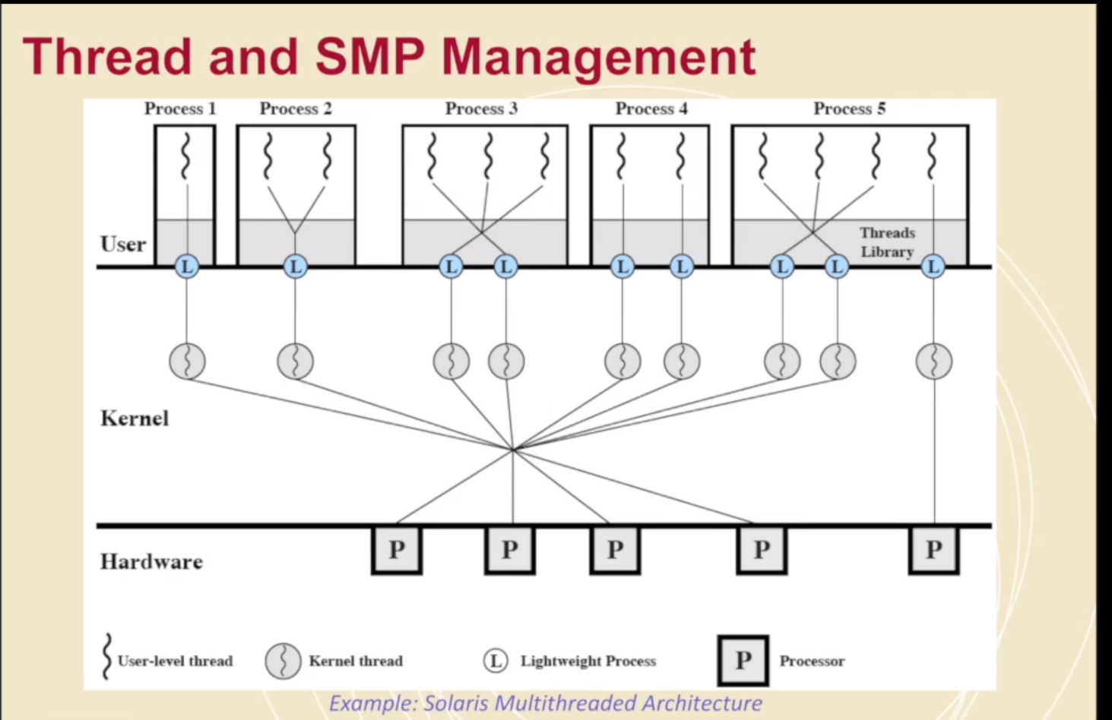

Slide 28
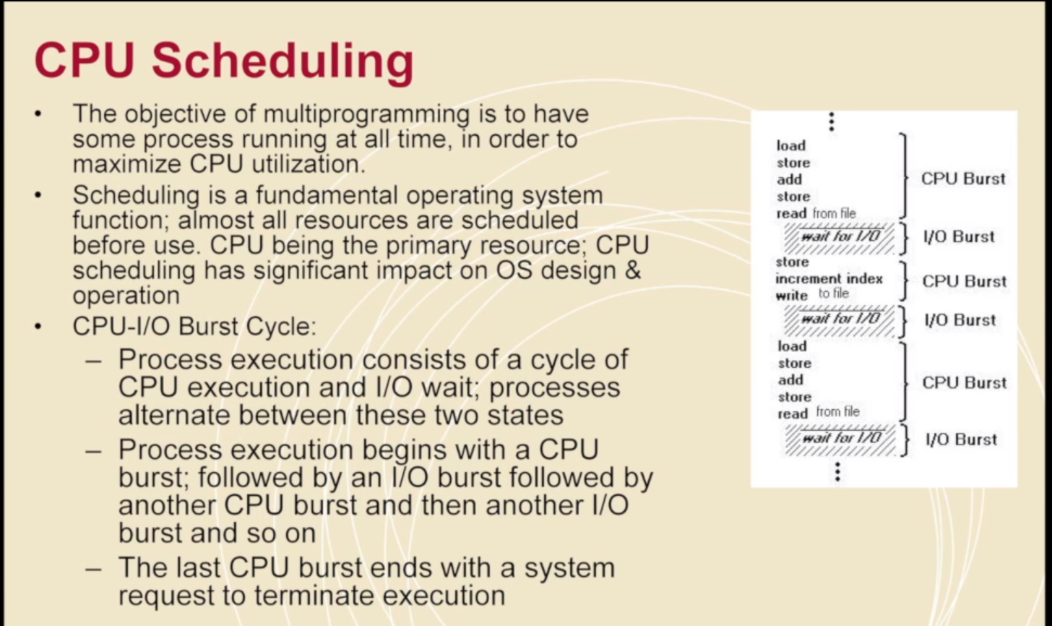

Slide 29
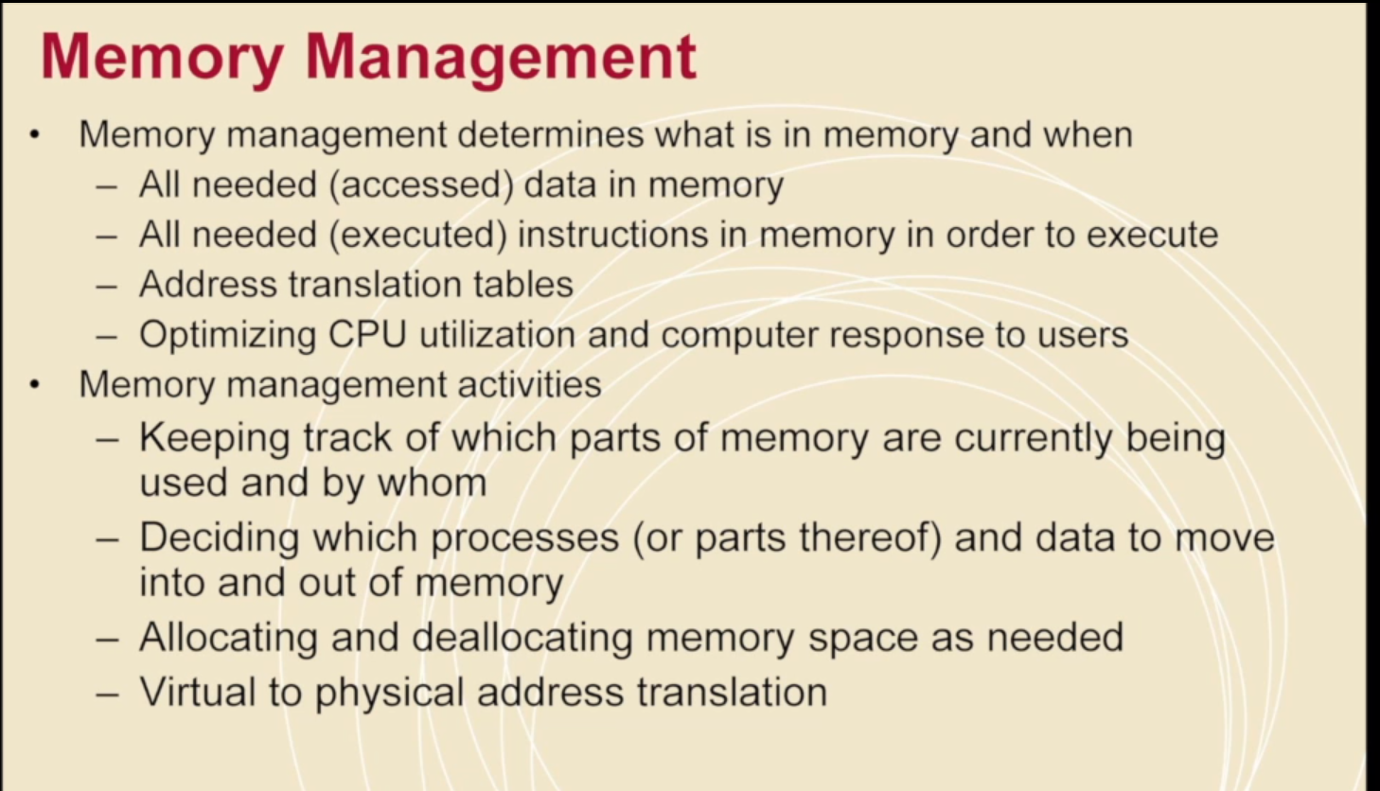

Slide 30
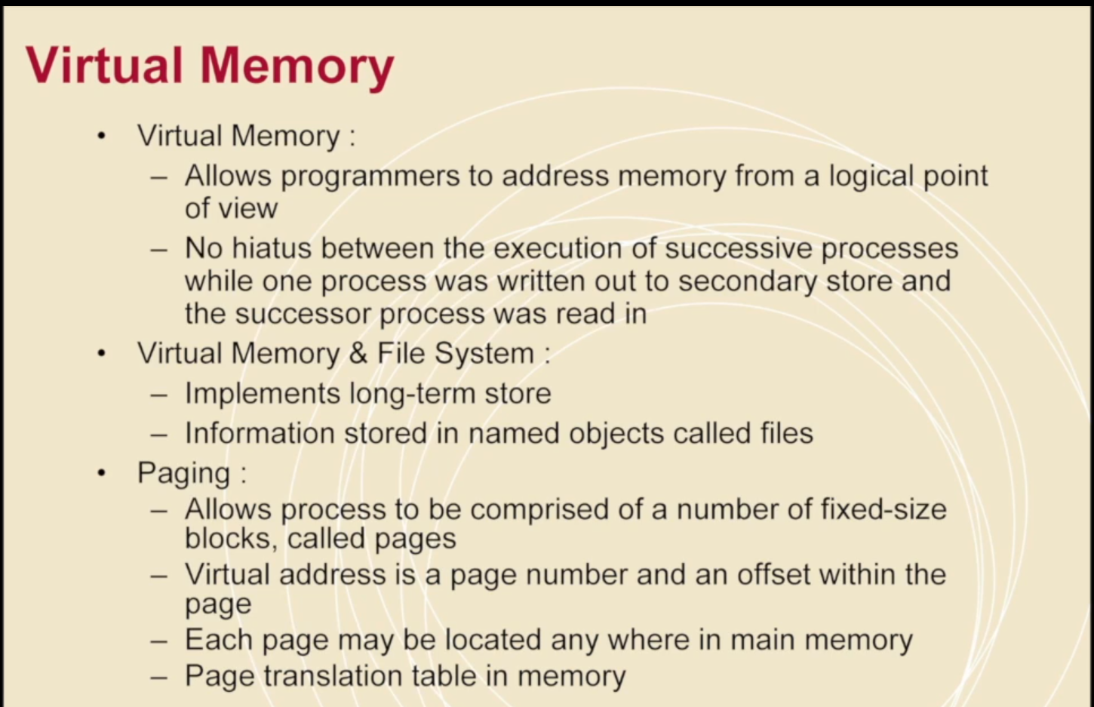

Slide 31
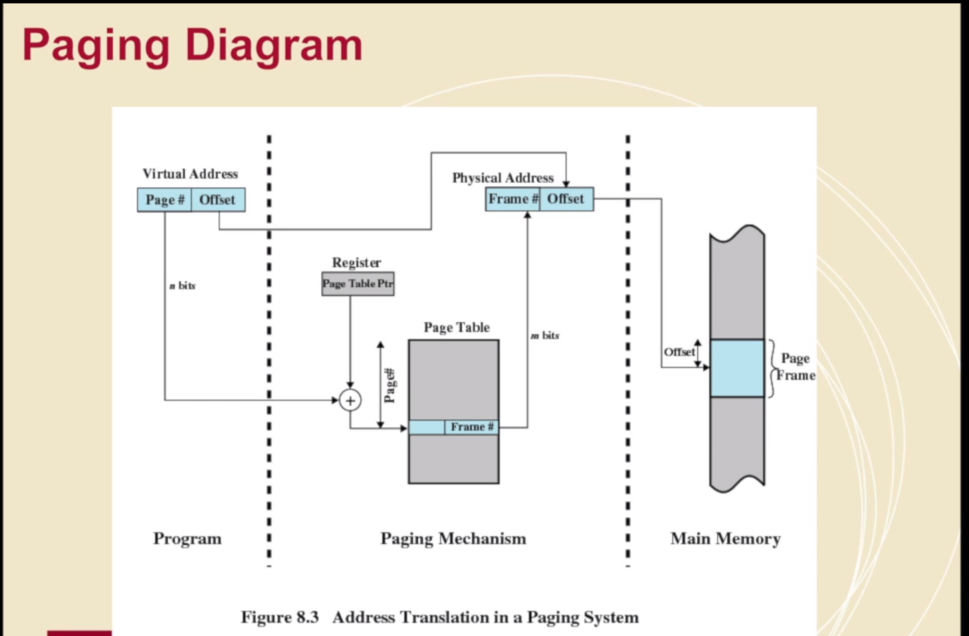

Slide 32
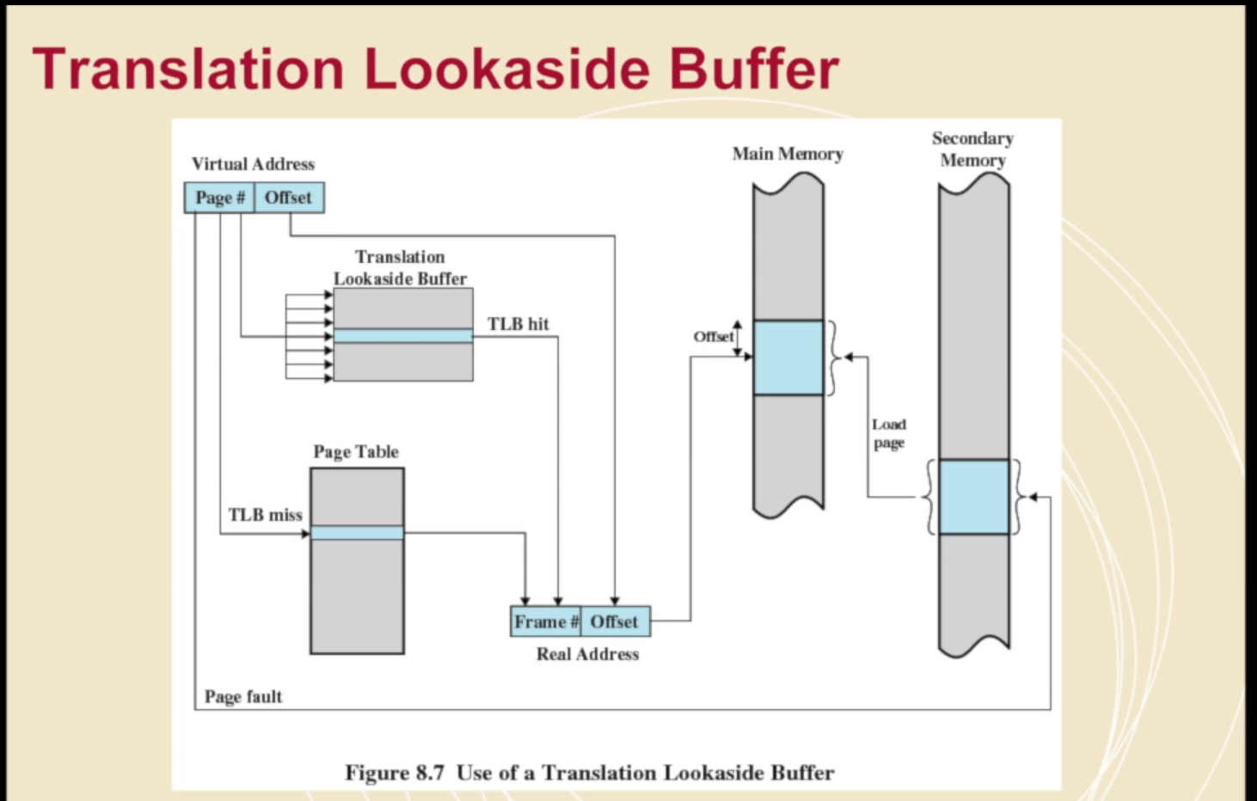

Slide 33
OS for HPC - Architecture
A fairly significant issue we’re looking at as we go here is essentially how do you setup the relationship between user jobs / OS/ nodes/ libraries

Slide 34
User Jobs
So obviously user jobs are user submitted
Managing user jobs as a scheduling concept has been discussed
At an OS level we’re interested in minimizing overhead while maximising usage
While keeping cluster and other jobs insulated from a bad job (and still using those resources)

Slide 35
Nodes
Remember not all nodes are the same and you could in theory have multiple compute nodes on a single piece of hardware (either through virtualization or just parallel threads/processes)
You can also have some really lightweight nodes if you have a cluster made up of an extremely large number of very low power cores (think pi’s or some custom component)
Communication elements may need their own ‘OS’ to handle their scheduling

Slide 36
Libraries
In the sane world we try and avoid having multiple versions of libraries going at once, and we try and avoid multiple programs depending on different versions of the same library
In practice, that’s isn’t going to work.
But libraries take memory, require updating/management etc.
(And maybe containerization that’s later in the course)

Slide 37
Architecture
This means a parallel OS may really be Linux +
You can have nodes with some ultra lightweight kernels that only do 1 job and one set of libraries. The scheduler can then kill/create whole ‘units’ of jobs (that contain a kernel and libraries).

Slide 38
Lightweight vs Fullweight Kernel
Mostly they are the same for things like interrupt handling, machine/system checks, signalling, file system support.
Big differences:
LWK have much more limited hardware abstraction
They have much less sophisticated process management, after all they manage a single job, so the kernel itself gets managed somewhere else.
LWK only contain drivers for the hardware they have, (as opposed to FWK which have drivers for hardware they might encounter).
LWK and Microkernels are not the same thing (necessarily)

Slide 39
So OS for a Cluster
You’ll have a FWK (regular Linux distro) on many nodes, and particularly nodes intended to manage other nodes
You have LWK on smaller/weaker nodes, or purely compute nodes. You can bundle the Kernel a job needs with only the libraries/drivers it needs to minimize space/memory used.

Slide 40
https://www.osti.gov/servlets/purl/1258200

Slide 41
Job scheduling
I didn’t dwell on it too much and don’t necessarily intend to expect you to do much with this
But job scheduling is essentially an exercise in optimally filling space while minimising how much your data moves

Slide 42

Hilbert Curve
If you imagine process scheduling as essentially a 1D plane of fixed size (size being the resources)
You can iteratively try and optimally fill that space with as many jobs as possible (Those are the lines)
In 2D this problem is the Hilbert curve as →
This is based on the work of Peano and Hilbert – yes, that Hilbert (who worked from the 1880- 1940s) as supervised Von Neuman
Notes:
https://en.wikipedia.org/wiki/Hilbert_curve
SLURM uses this

Slide 43
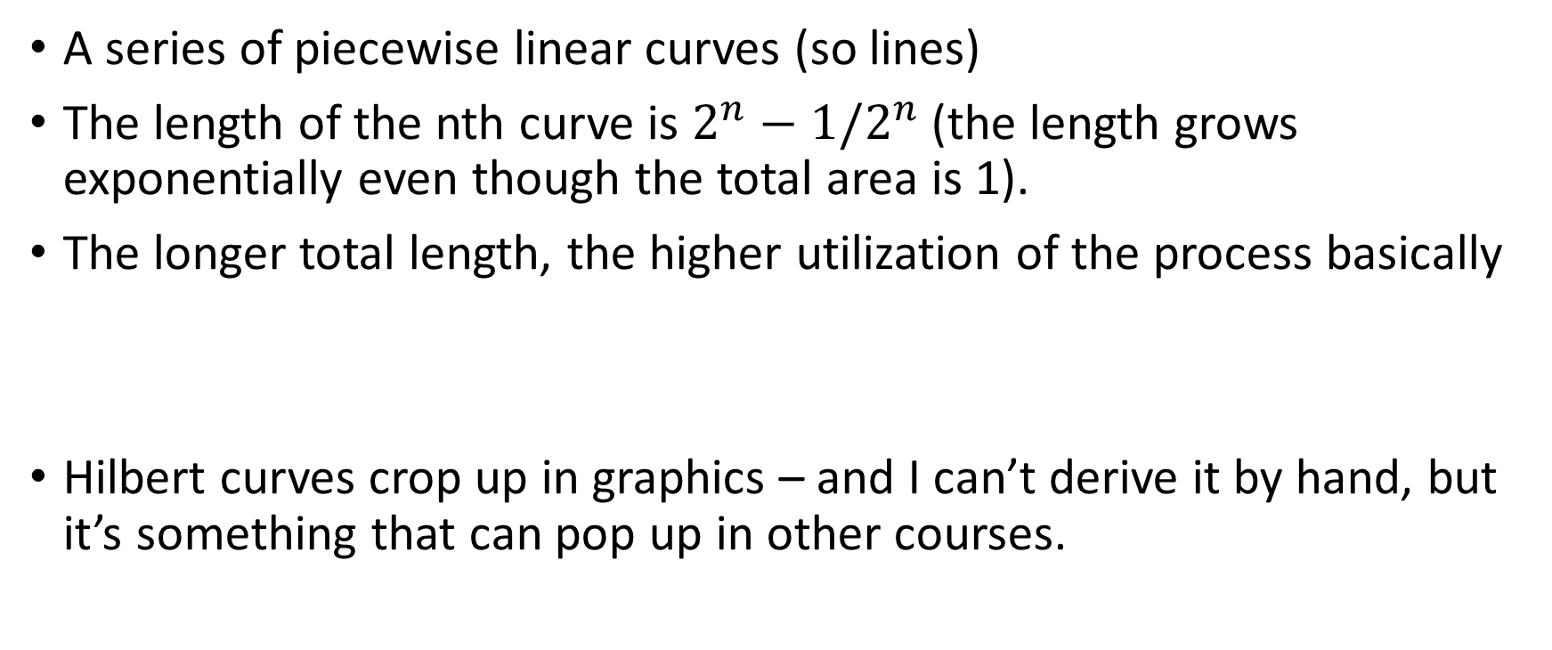
Hilbert Curve
A series of piecewise linear curves (so lines)
The length of the nth curve is $2^{n}−1/2^{n}$ (the length grows exponentially even though the total area is 1).
The longer total length, the higher utilization of the process basically
Hilbert curves crop up in graphics – and I can’t derive it by hand, but it’s something that can pop up in other courses.

Slide 44
Visualization

Slide 45
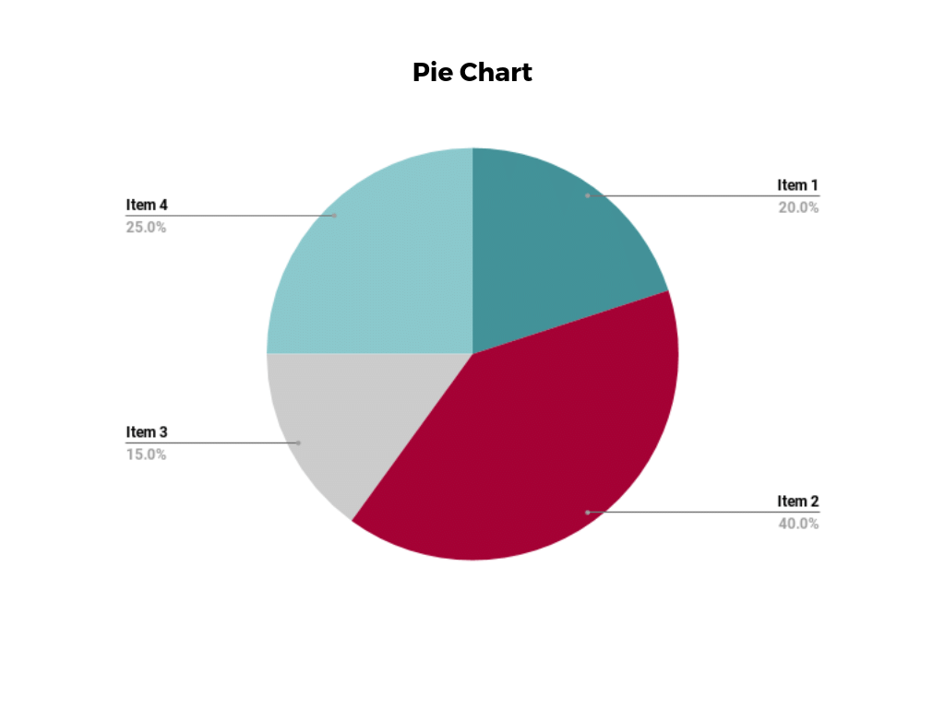
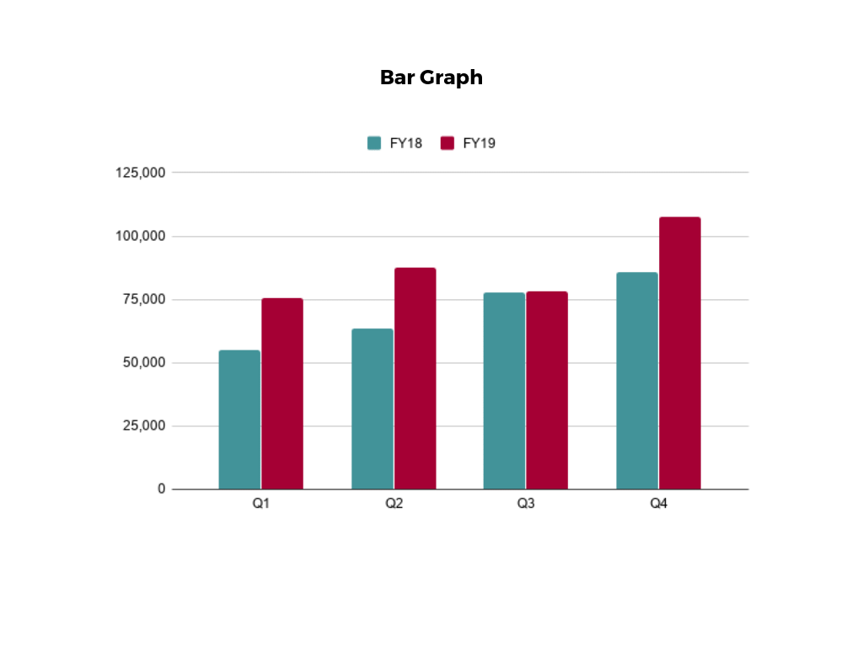
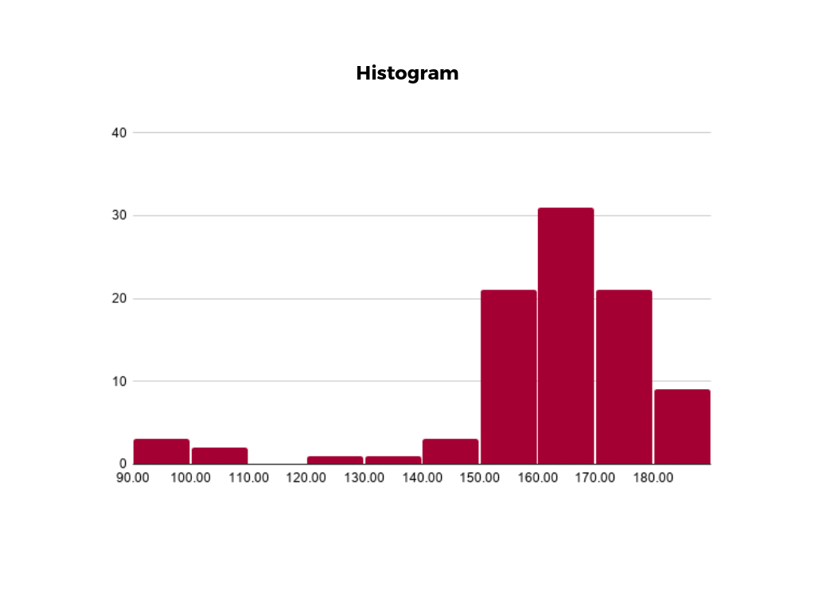
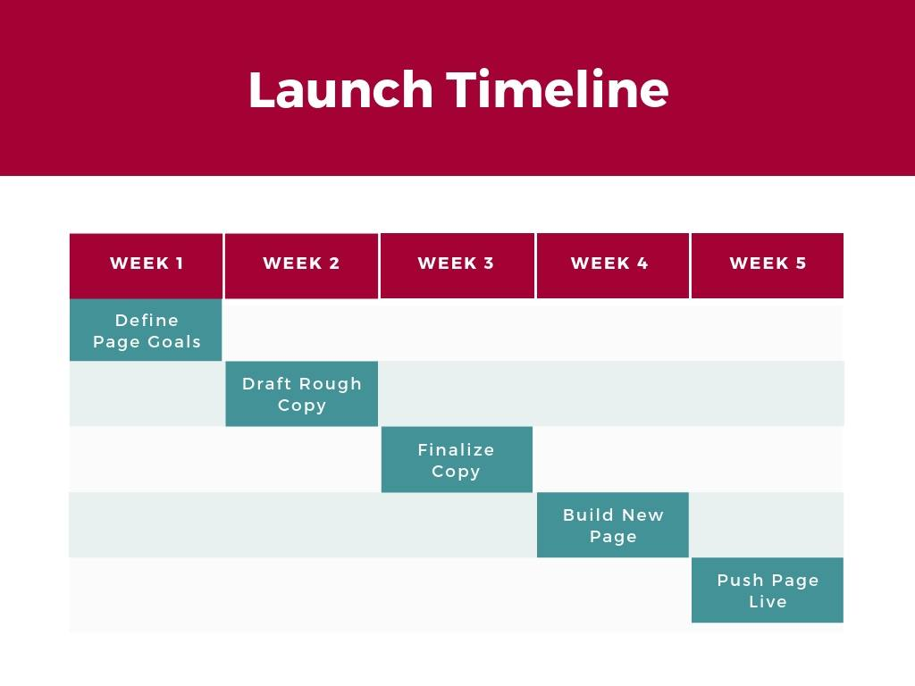
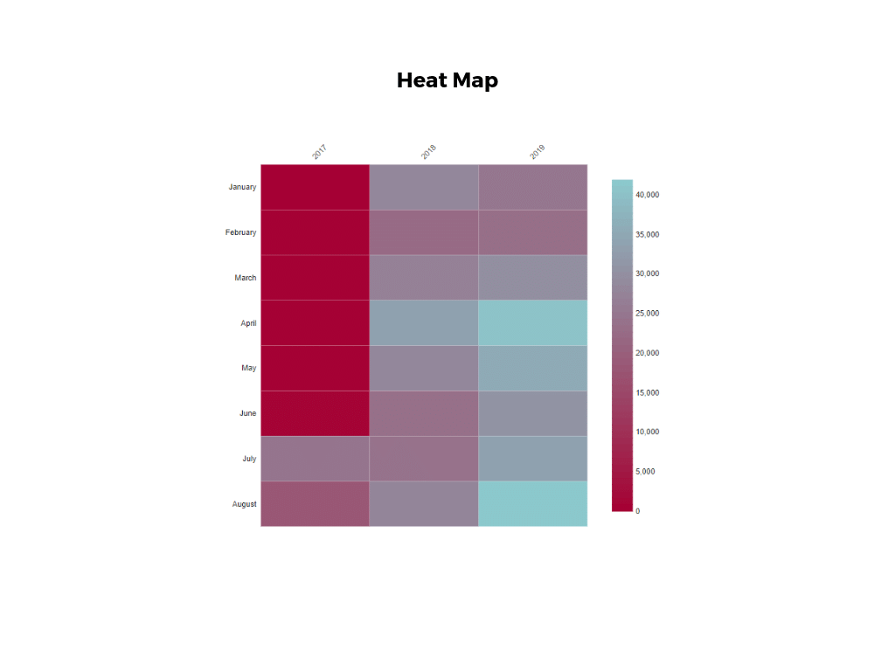
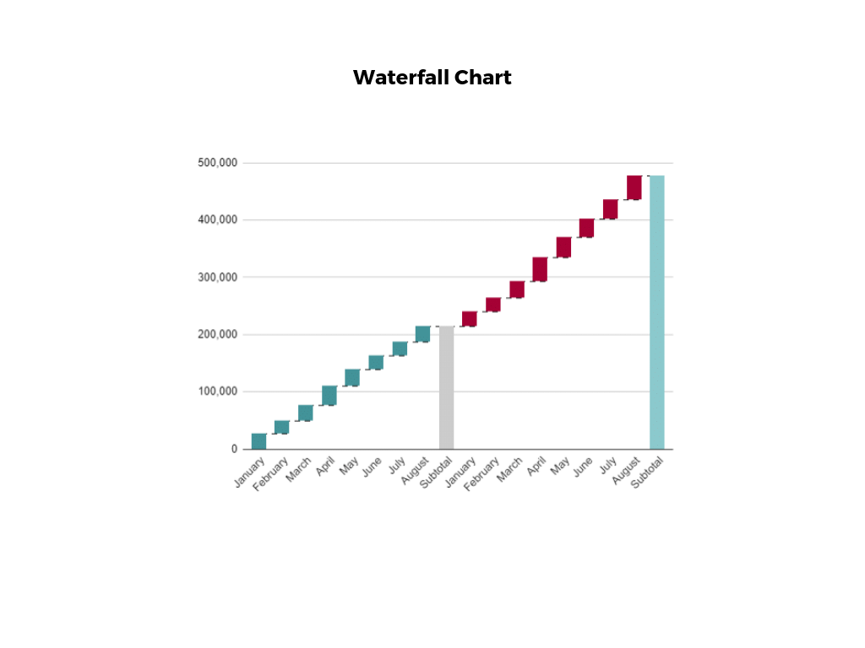
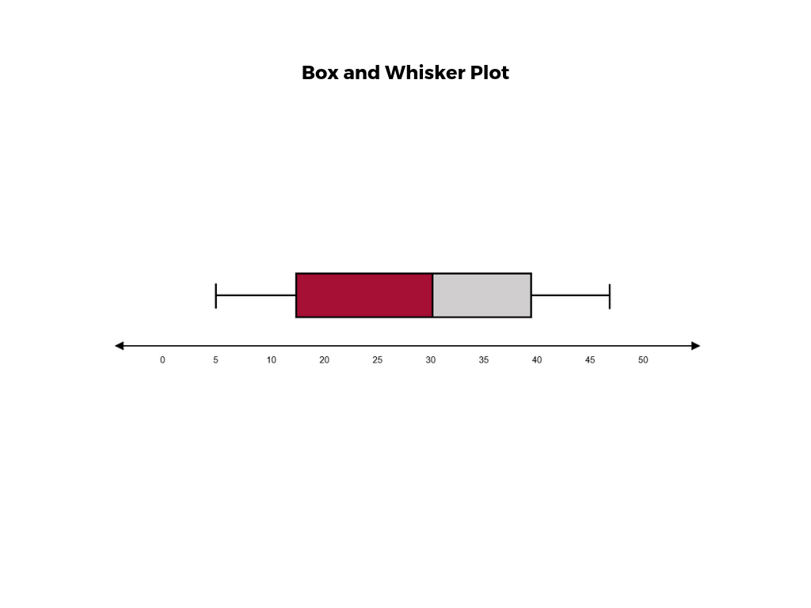
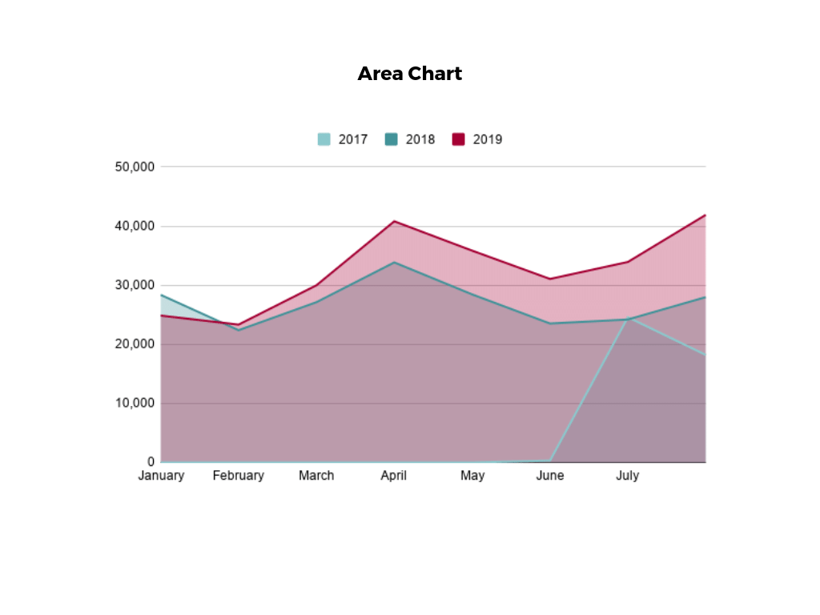
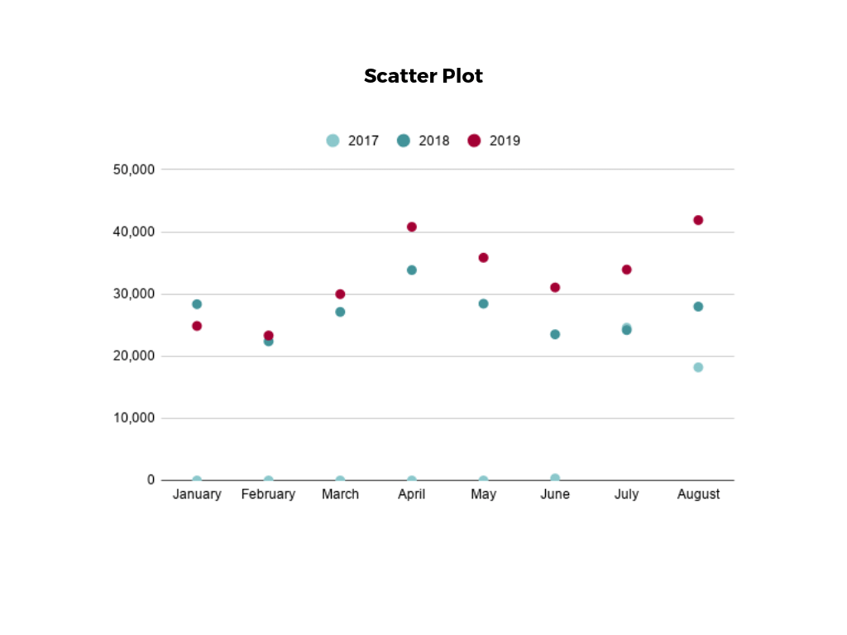
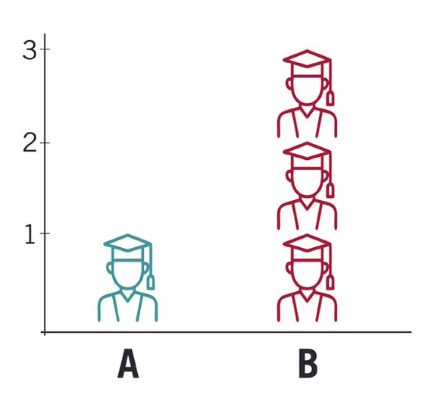
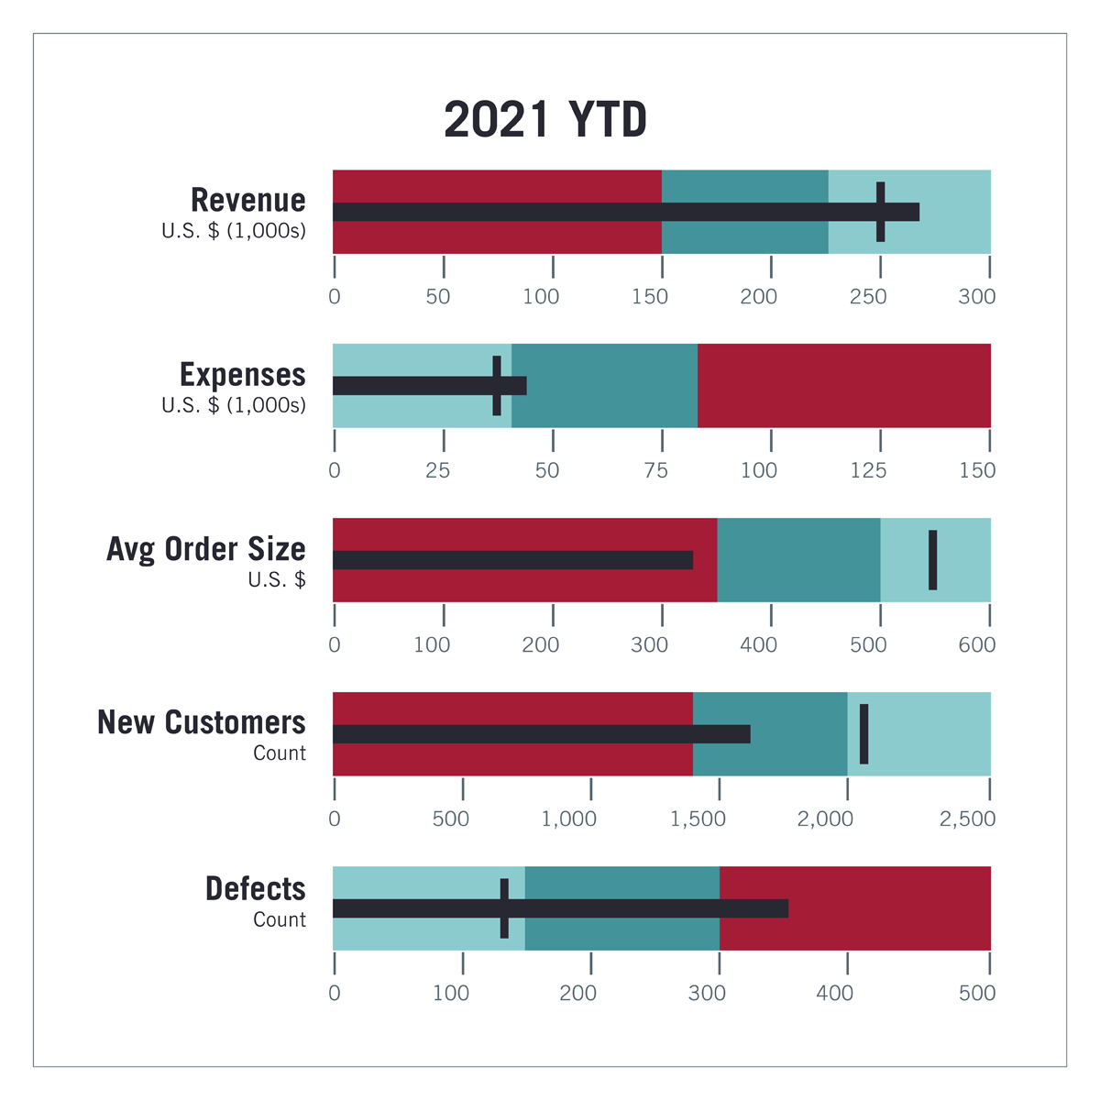
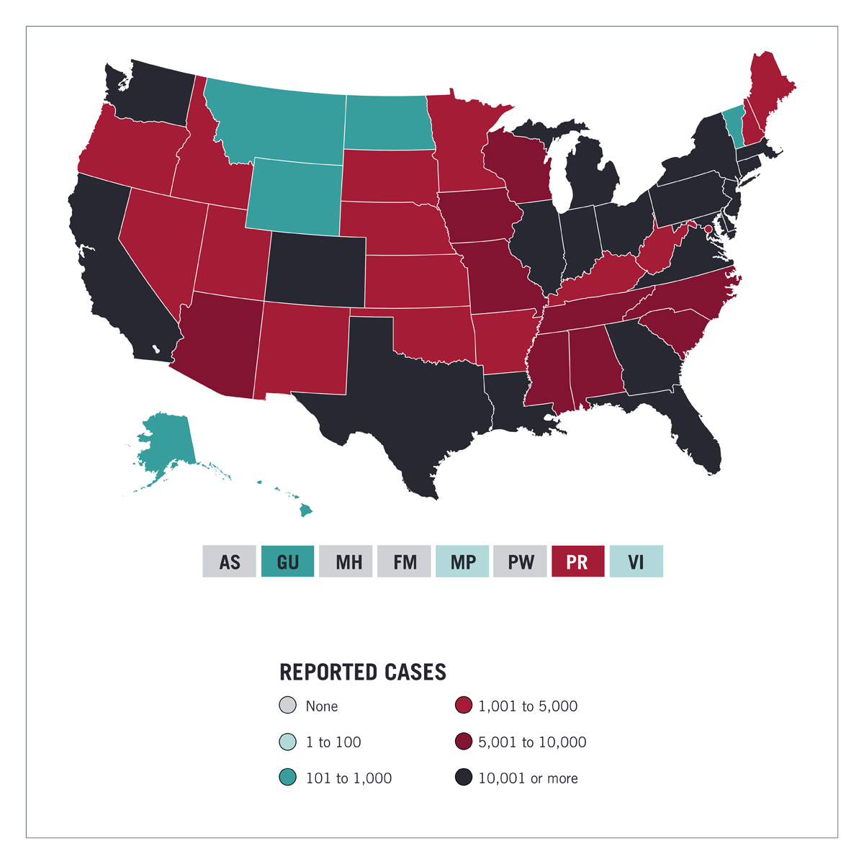
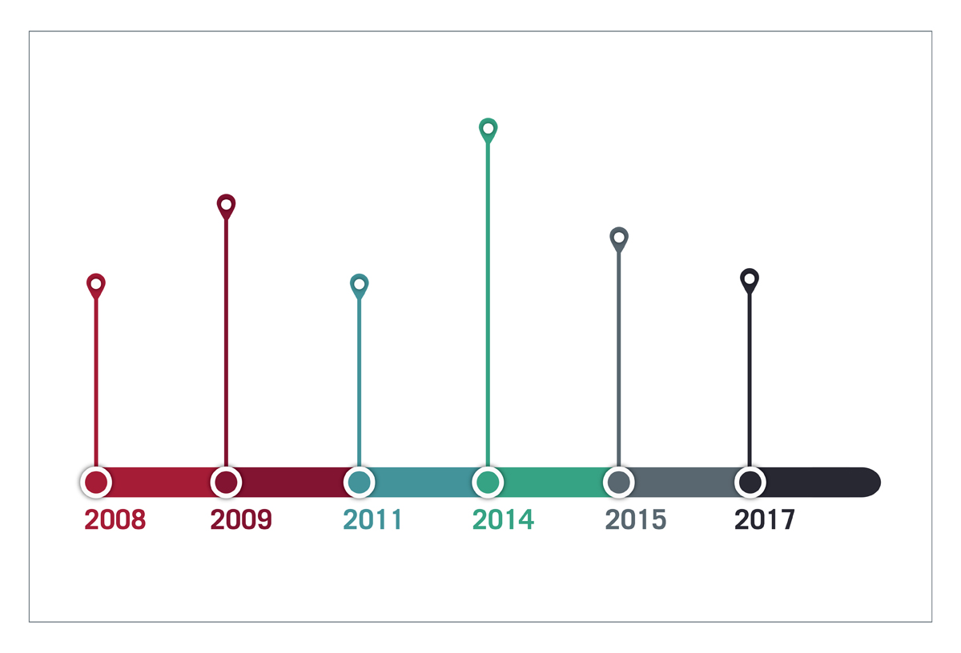
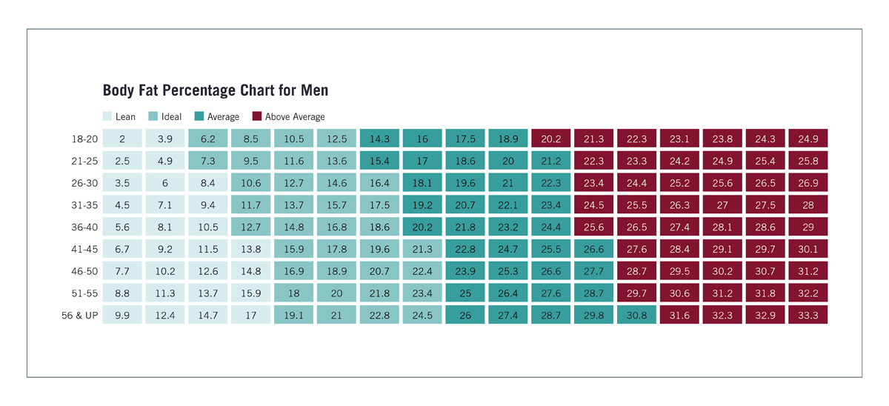
Graphs/Charts
Notes:
https://online.hbs.edu/blog/post/data-visualization-techniques
top row: pie, bar, histogram, ghantt Bottom row: Pictogram, timeline, highlight table, bullet graph, Choropleth maps
A bullet graph is a variation of a bar graph that can act as an alternative to dashboard gauges to represent performance data. The main use for a bullet graph is to inform the viewer of how a business is performing in comparison to benchmarks that are in place for key business metrics.
In a bullet graph, the darker horizontal bar in the middle of the chart represents the actual value, while the vertical line represents a comparative value, or target. If the horizontal bar passes the vertical line, the target for that metric has been surpassed. Additionally, the segmented colored sections behind the horizontal bar represent range scores, such as “poor,” “fair,” or “good.”
A choropleth map uses color, shading, and other patterns to visualize numerical values across geographic regions. These visualizations use a progression of color (or shading) on a spectrum to distinguish high values from low.
Choropleth maps allow viewers to see how a variable changes from one region to the next. A potential downside to this type of visualization is that the exact numerical values aren’t easily accessible because the colors represent a range of values. Some data visualization tools, however, allow you to add interactivity to your map so the exact values are accessible.

Slide 46
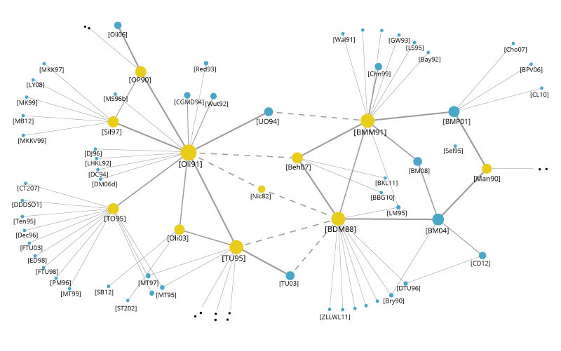
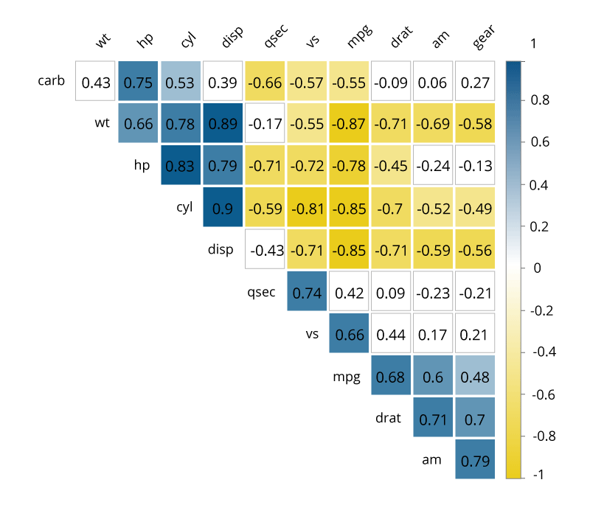
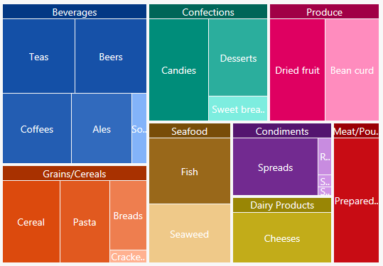
A couple of other useful ones
Notes:
Network diagram, correlation matrix, Tree map
https://www.kdnuggets.com/2019/04/best-data-visualization-techniques.html
https://www.mygreatlearning.com/blog/understanding-data-visualization-techniques/

Slide 47
Good Read
https://blog.hubspot.com/marketing/great-data-visualization-examples
Sort of out of scope for us, but a useful read on some other visualizations used in public graphs/marketing
And some good ‘what not to do’.

Slide 48
Scientific Visualization
While related – usually with scientific visualization you’re trying to picture a thing which can’t be seen

Slide 49
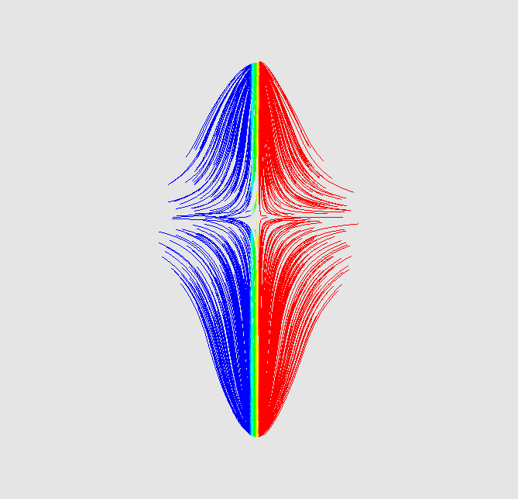
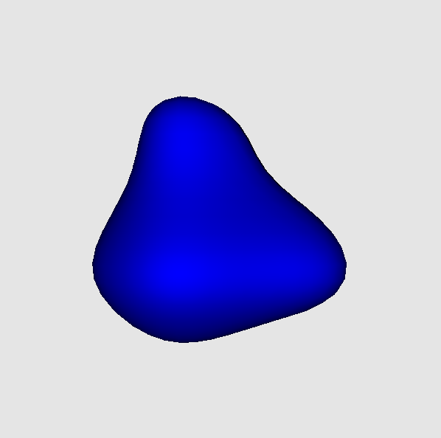

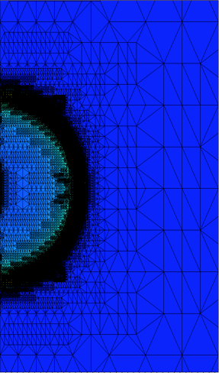
Visualization Concepts
Many scientific visualizations incorporate at least one of some foundational visualization concepts: streamlines, isosurfaces, volume rendering by ray tracing, and mesh tessellations.

Slide 50
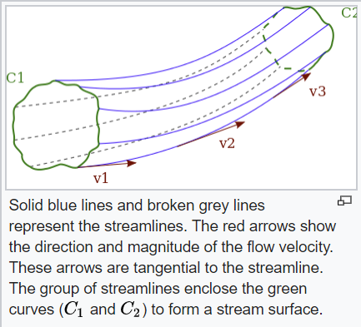
Streamlines
Curves tangent to the velocity vector of flow
(Fluid mechanics stuff)
Notes:
https://en.wikipedia.org/wiki/Streamlines,_streaklines,_and_pathlines

Slide 51
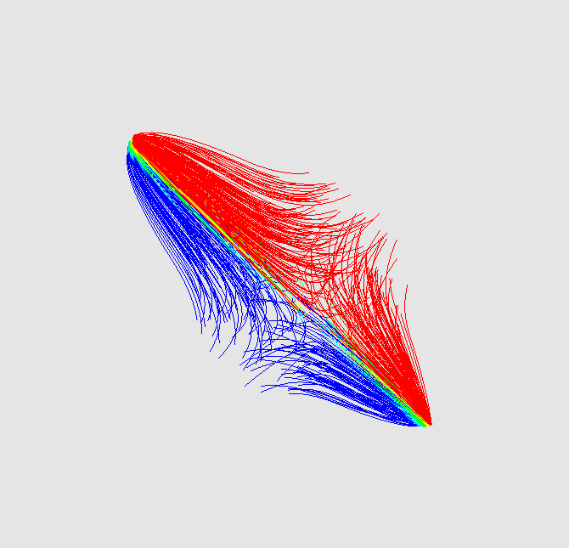
Streamlines
Streamlines take a vector field as input and show curves that are tangent to the vector field
. Streamline example using the gradient of the function f(x,y,z) = $2550\sin\left(100x\right)\sin{(30y)\cos{(40z)}}$ as input. Two different 3-D views are provided.

Slide 52
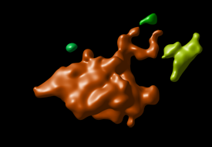
Isosurfaces
3D representation of points with equal value
Notes:
https://svi.nl/Isosurface

Slide 53
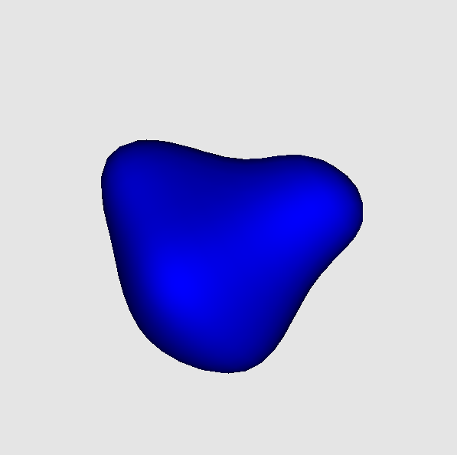
Isosurfaces
Isosurfaces are surfaces which connect data points which have the same value.
. Isosurface example of the function f(x,y,z) = $2550\sin\left(10x\right)\sin{(10y)\cos{(10z)}}$ as input with the isosurface value set at 200. Two different 3-D views are provided.

Slide 54
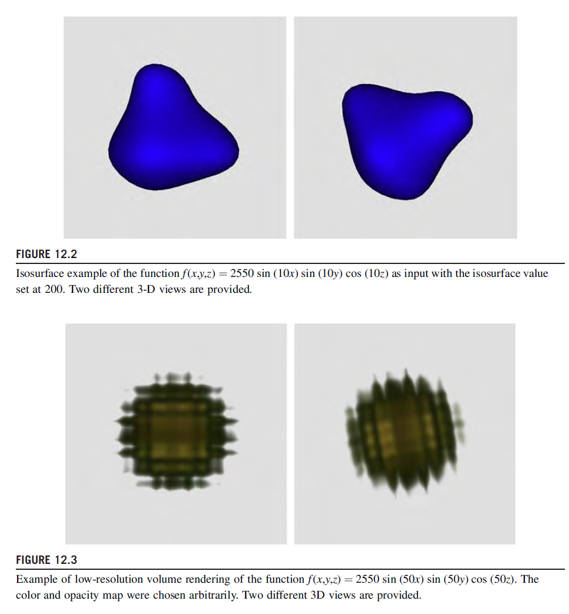

Slide 55
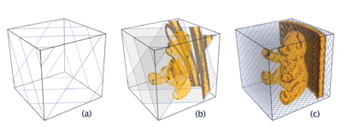
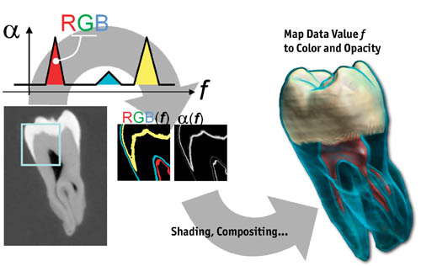
Volume Rendering
2D projection of 3D modelled data
Notes:
https://developer.download.nvidia.com/books/HTML/gpugems/gpugems_ch39.html

Slide 56

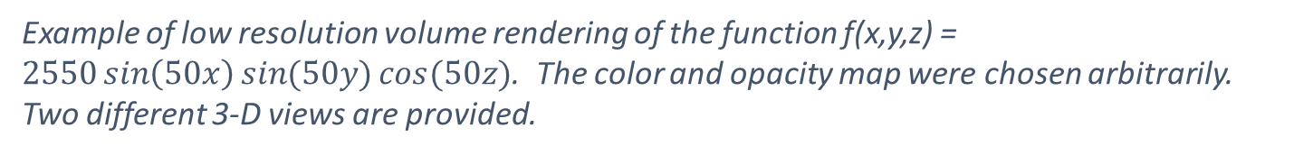
Volume Rendering
Volume rendering by ray tracing casts rays through the data volume and sample the volume through which the ray passes.
Example of low resolution volume rendering of the function f(x,y,z) = $2550\sin\left(50x\right)\sin{(50y)\cos{(50z)}}$. The color and opacity map were chosen arbitrarily. Two different 3-D views are provided.

Slide 57
Mesh Tessellation
Mesh tessellations visualize data points and their connectivities to other data points using polygons.

Slide 58
More Specific?
https://svs.gsfc.nasa.gov/Gallery/index.html
Nasa has a wonderful gallery of scientific visualizations

Slide 59
Siggraph
https://blog.siggraph.org/2019/07/why-cinematic-scientific-visualization-is-more-important-than-ever.html/
Good article covering some of what siggraph has had on this (Siggraph is the ACM special interest group on graphics)
They’ve had sessions on scientific visualization

Slide 60
Libraries
So in this context we don’t do visualisation ourselves, we just use libraries

Slide 61
Common Tools for Scientific Visualization
Gnuplot is a simple command line visualization tool for 2-D and 3-D plots.
Matplotlib is a Python based visualization tool with easy integration to other libraries with Python bindings.
VTK is an open source collection of visualization algorithms for creating application specific visualization solutions.
ParaView and VisIt are turnkey visualization solutions incorporating VTK algorithms but providing a GUI and scripting interface for visualization.
Notes:
Turnkey: Americanism for ‘fixed functionality to solve a specific problem”

Slide 62
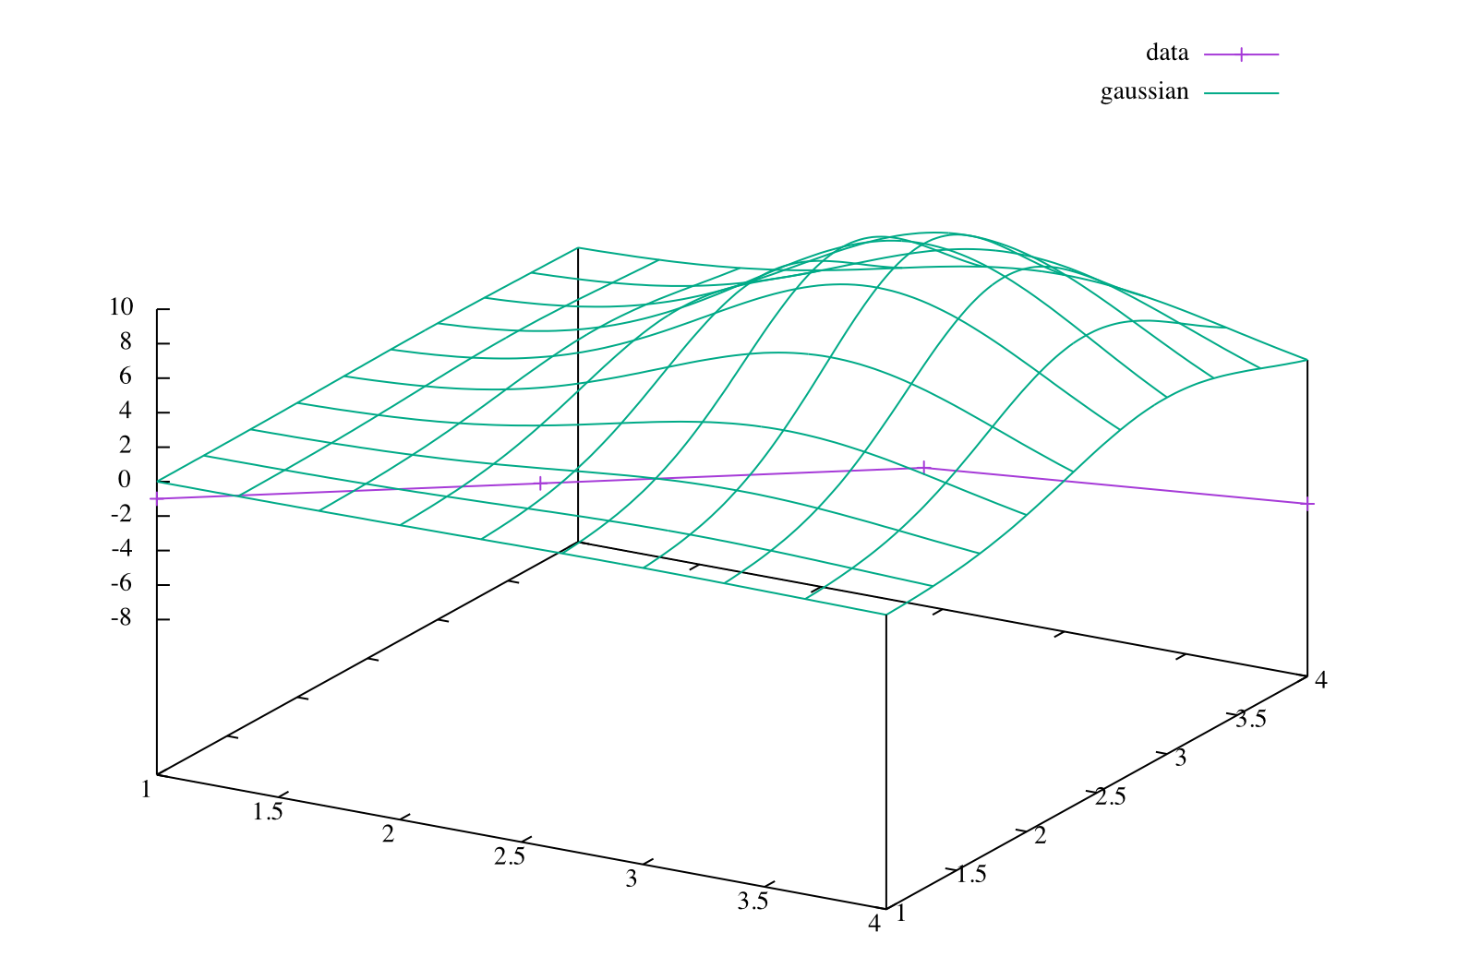
Gnuplot
splot “gnu_example.dat” with linespoints title “data”, 10*exp(-(x-3)**2-(y-3)**2) title “gaussian”

Slide 63
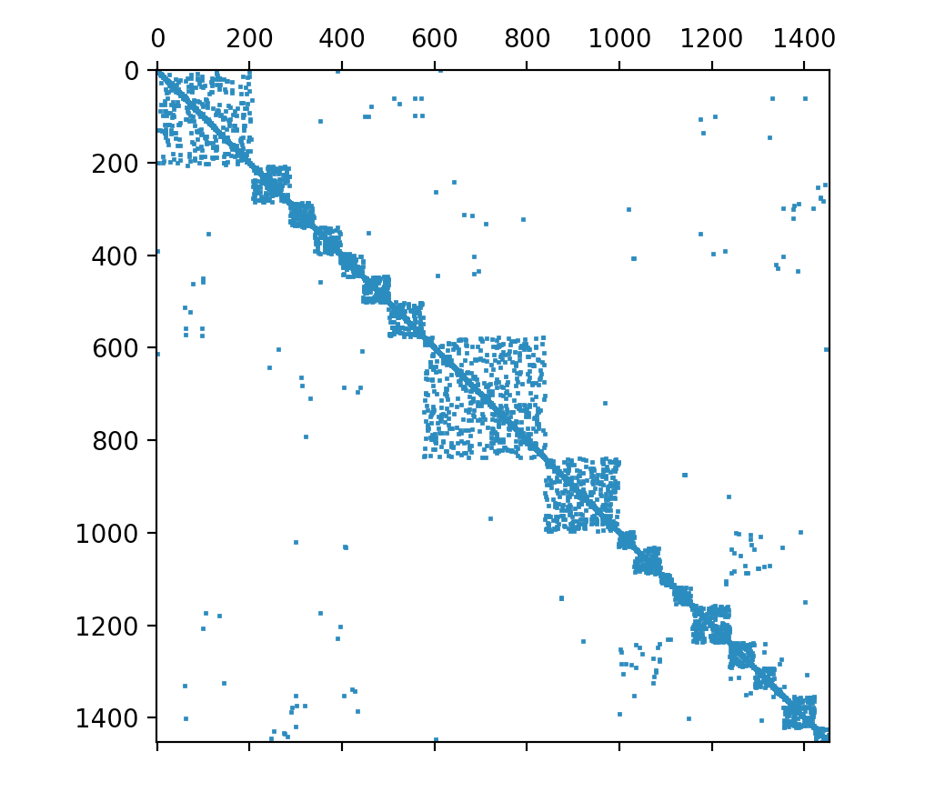

Matplotlib

Slide 64



VTK Examples

Slide 65

More VTK
This is a plot of particle locations
It’s importing a bunch of stuff from python, but the basic idea is that you can visualise path traces!

Slide 66
This thing is an isosurface

Slide 67
Paraview
ParaView is a HPC specific set of solutions based on VTK for specific problems
If you are interested (you probably aren’t) they have a 159 page tutorial: https://www.paraview.org/Wiki/images/6/6e/ParaViewTutorial54.pdf
https://www.paraview.org/

Slide 68

Global Water Surface temperatures
Los Alamos National Laboratory
Notes:
https://www.paraview.org/gallery/

Slide 69

fan / nozzle and ground plane streamlines. UFO-CFD: https://sites.google.com/site/ufocfdso

Slide 70

Paraview Example

Slide 71

VisIt Example

Slide 72

VisIt
https://wci.llnl.gov/simulation/computer-codes/visit/

